Slide 1
Hospital Management System
Presented By:
Aziza Ashrafi 2013-1-60-008
Ifrat Jahan 2014-2-60-051
Md. Lizur Rahman 2014-3-60-014

Slide 2
Content
Introduction
Motivation
Requirement analysis
Scope
System diagram
Limitation
Future Work
Conclusion

Slide 3
Introduction
Our Software is for the automation of Hospital Management.
It maintains two levels of users –
Administrator Level
User Level

Slide 4
Introduction
Three main stakeholders of this software are-
Admin
Patient
Doctor

Slide 5
Introduction
Admin:
Major tasks of admin includes-
An Admin can add another admin.
Add Doctors is also a part of admin.
Admin can view Feedbacks which are submitted by the patient.

Slide 6
Introduction
Patient
Major parts of patient includes-
A patient can register and create his/her own account.
Patients can view the doctor’s info.
Patient can search doctor in terms of name or category to find specific doctors.
Patient can make appointment and also can cancel appointment.
Cont…

Slide 7
Introduction
Patient
Major parts of patient includes-
Patient can view his/her prescription, which is created by doctor.
Patient can add any kind of Feedback, later which is checked by admin.

Slide 8
Introduction
Doctor:
Mainly Doctor’s parts includes-
A doctor can change his/her own password.
Doctor’s can view their own appointment list.
Doctor can give prescription.
Doctor’s can search medicine in terms of company name or compound name.

Slide 9
Motivation
To computerize all details regarding patient details & doctor details.
keeping track of all the hospital activities and on paper is very cumbersome and error prone.
It also is very inefficient and a time-consuming process .
Observing the continuous increase in population and number of people visiting the hospital. Recording and maintaining all these records is highly unreliable and inefficient.
It is also not economically & technically feasible to maintain these records on paper

Slide 10
Requirement Analysis
Requirement Analysis is divided into two parts-
Functional requirement
Non-functional requirement

Slide 11
Requirement Analysis
Functional requirements
Login (No user can use this system without login)
Add User (An admin can add different user)
Change Password (Admin, doctors can change their password)
Add Doctor (No doctor can be added without admin)
Register (Patient can register and create account to this system)
View Doctor Info (Patient can be find any information of doctor)
Book, View, cancel appointment (Patient can create, view and cancel appointment)

Slide 12
Requirement Analysis
Functional requirements-
Provide prescription (This is one of the main task of doctor)
Feedback (For improving the system)

Slide 13
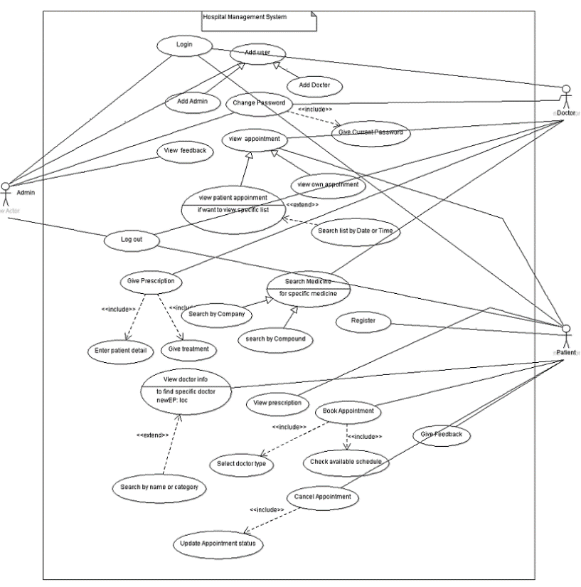
System Diagram
Use Case:

Slide 14
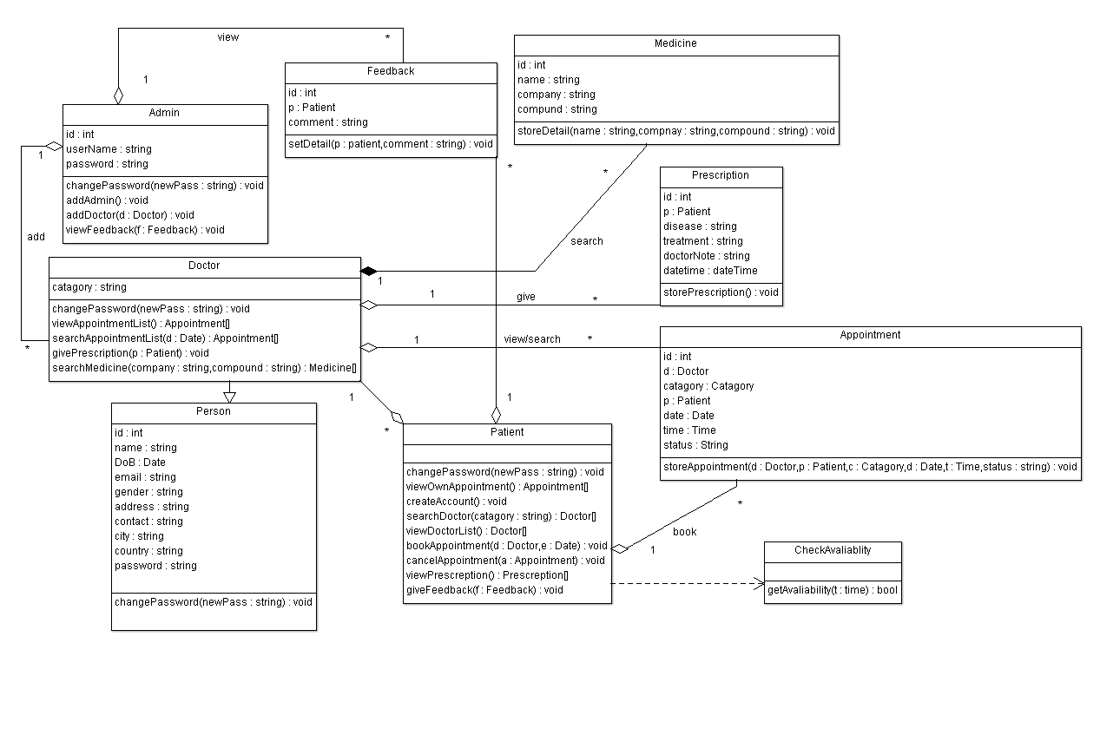
System Diagram
Class diagram:

Slide 15
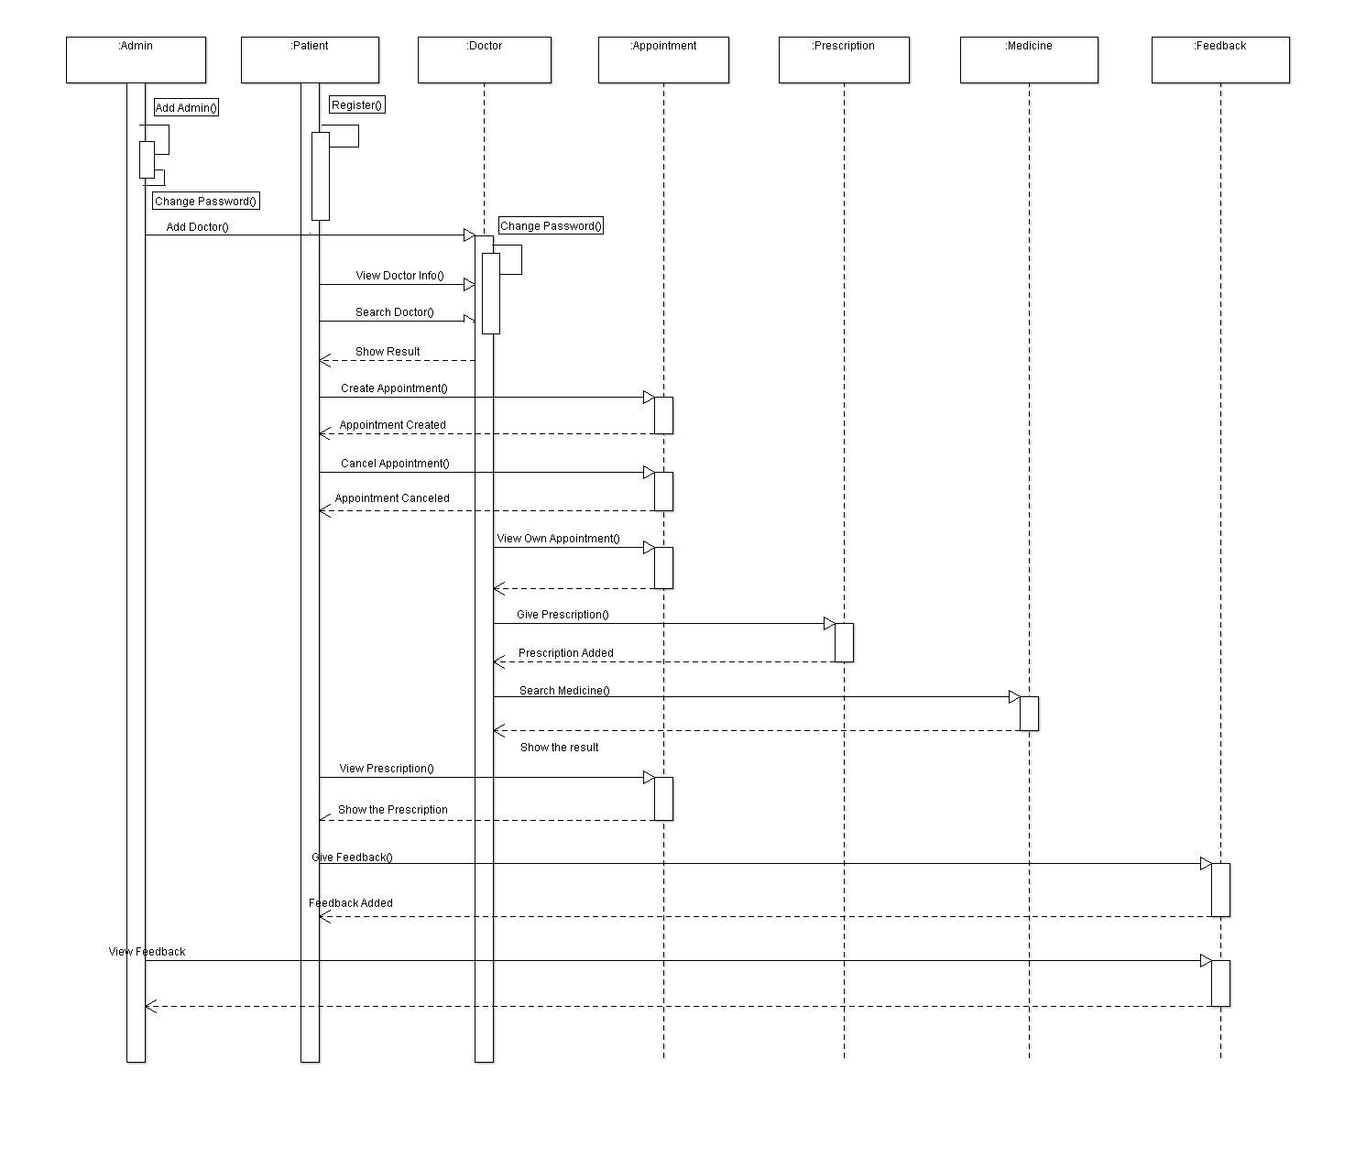
System Diagram
Sequence diagram:

Slide 16
Scope:
The system will be used in any Hospital, Clinic, Dispensary or Pathology labs in any Hospital to get the information from the patients and then storing that data for future usage.

Slide 17
Limitation:
The size of the database increases day-by-day, increasing the load on the database back up and data maintenance activity.
Training for simple computer operations is necessary for the users working on the system.

Slide 18
Future Work:
We can add receptionist part .
We can also generate different lab test result.
In Future, we will add different test report generation part and will keep a payment option.
We can enhance this system by including more facilities like pharmacy system for the stock details of medicines in the pharmacy.

Slide 19
Conclusion
The project Hospital Management System is for computerizing the working in a hospital. It is a great improvement over the manual system. The computerization of the system has speed up the process. In the current system, the front office managing is very slow. The software takes care of all the requirements of an average hospital and is capable to provide easy and effective storage of information related to patients that come up to the hospital.

Slide 20
Thank You

